Slide 1
Loading Transaction Data using Write Optimized DSO
Milind Parab

Slide 2
Pre-Requisites for the Demo.
Load Master Data.
Create Flat File Transaction Data.
Create Info Objects.
SMID : SIDxx
PID: PIDxx
Quantity: QTY_xx
Sales: SREV_xx
Profit: PR_xx

Slide 3
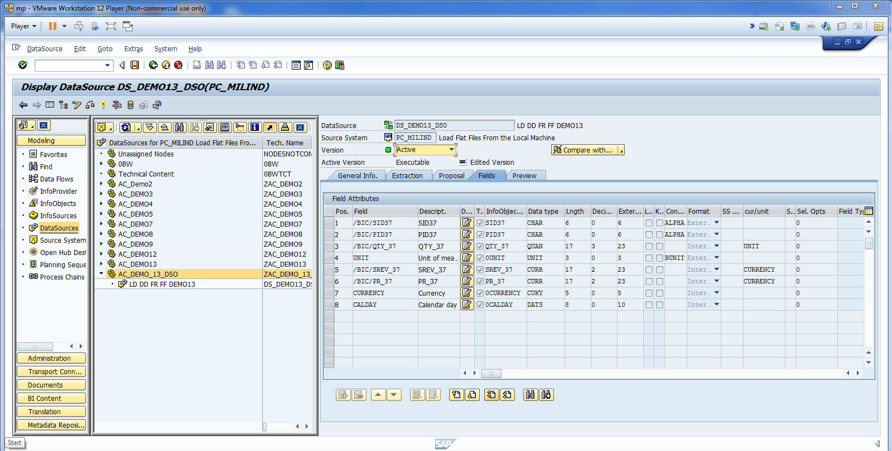
Map all fields and activate DSO.

Slide 4
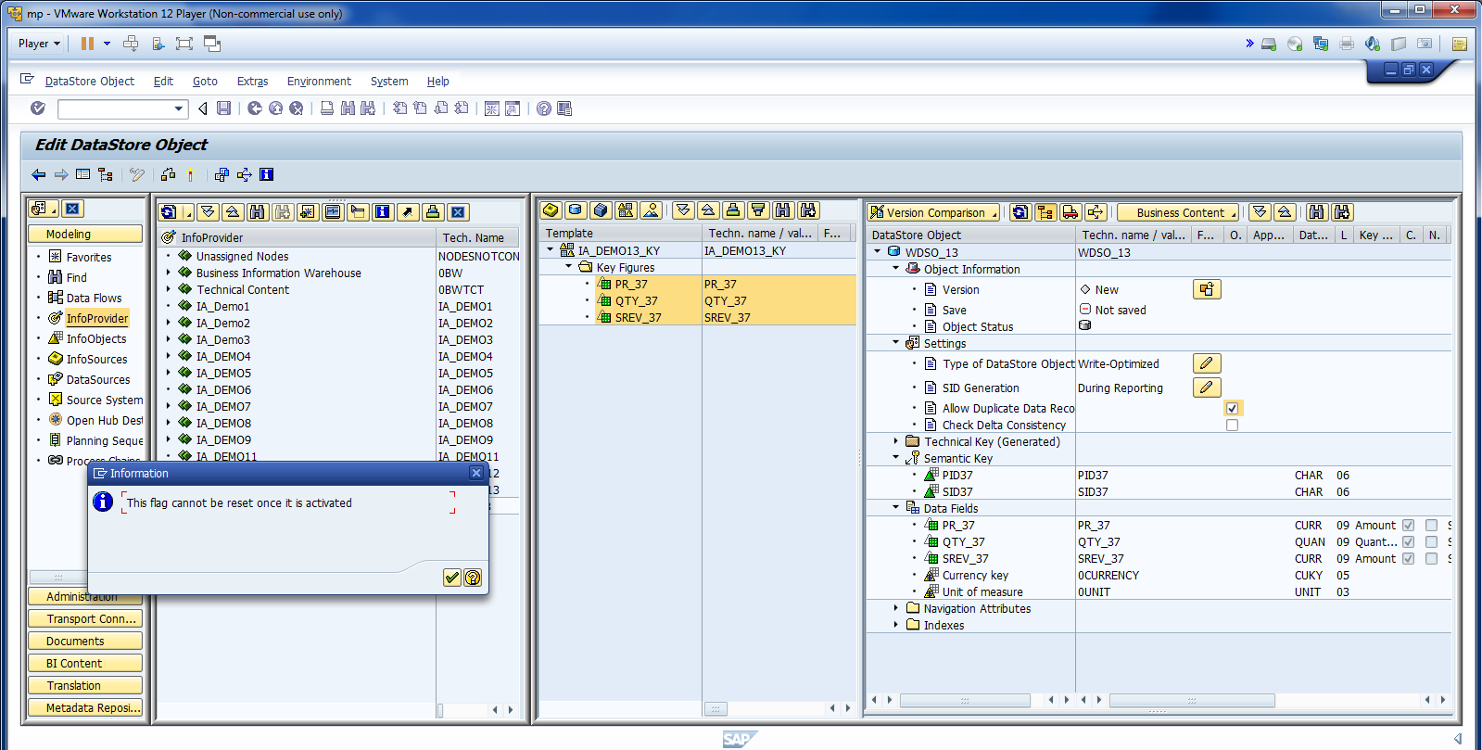
Change DSO type and allow duplicate record.

Slide 5
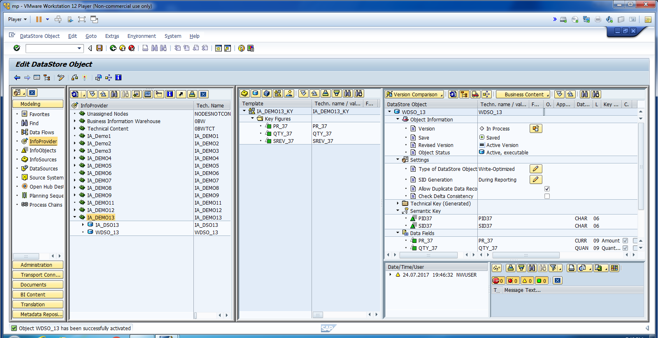
Activate DSO.

Slide 6
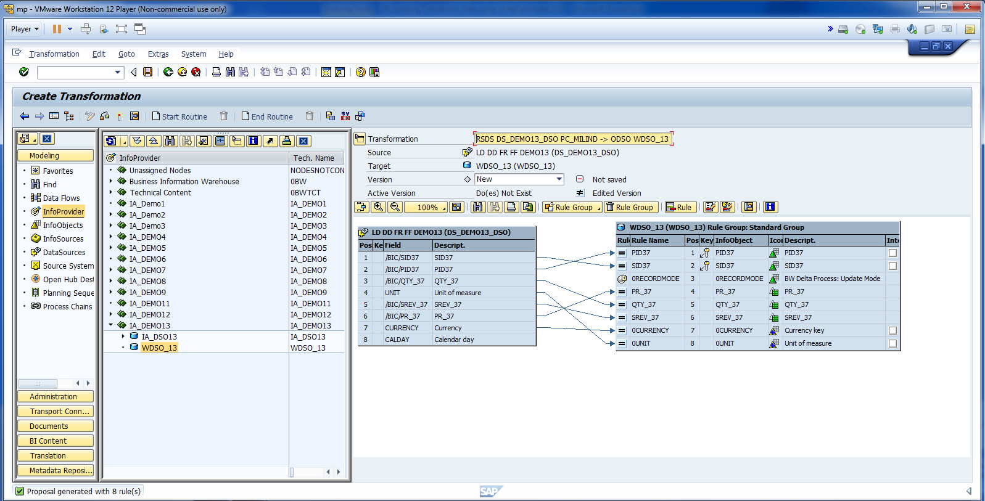
Create Transformation.

Slide 7
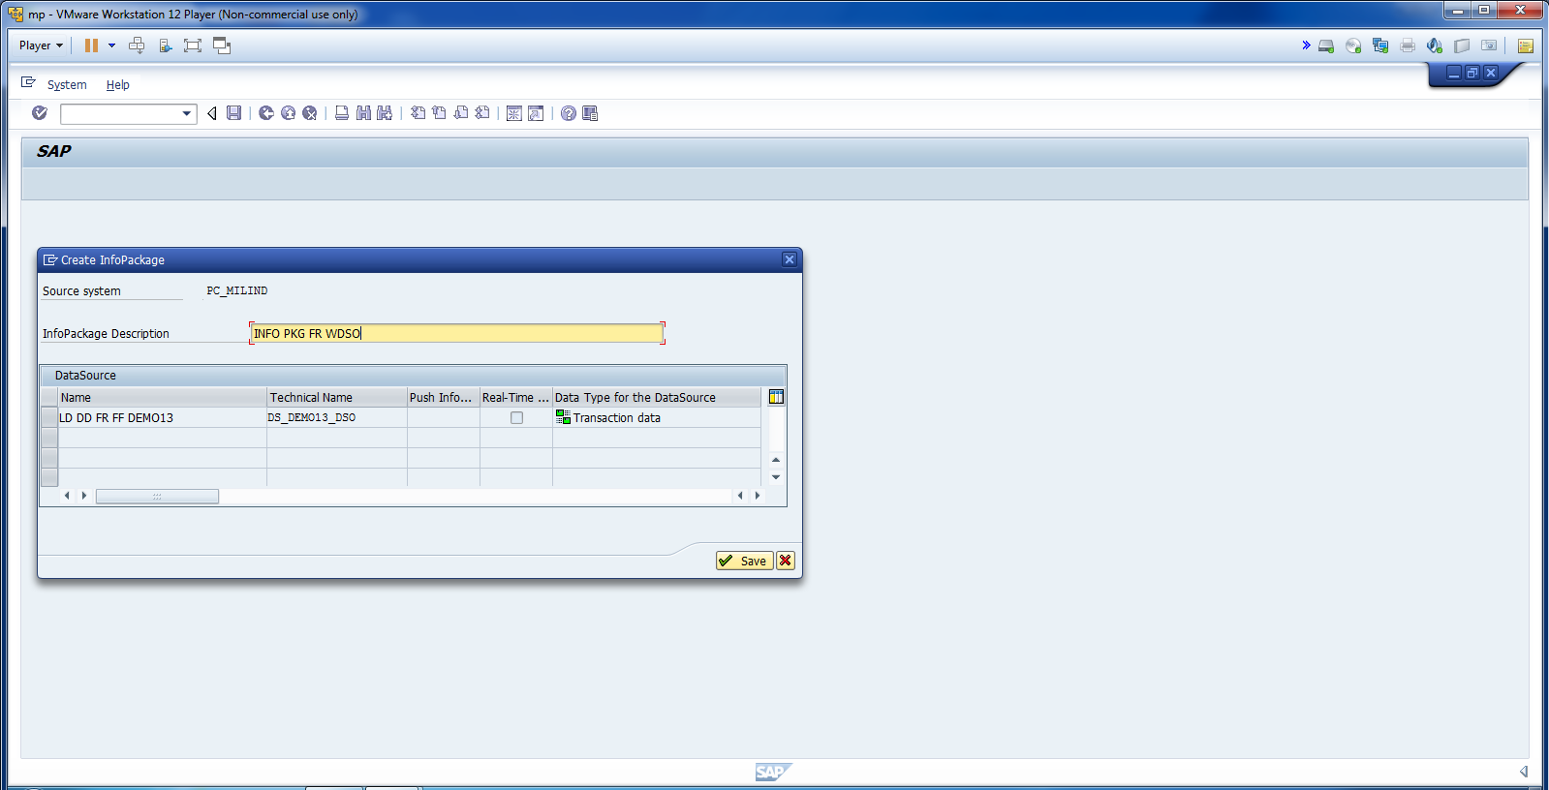
Create Info Package.

Slide 8
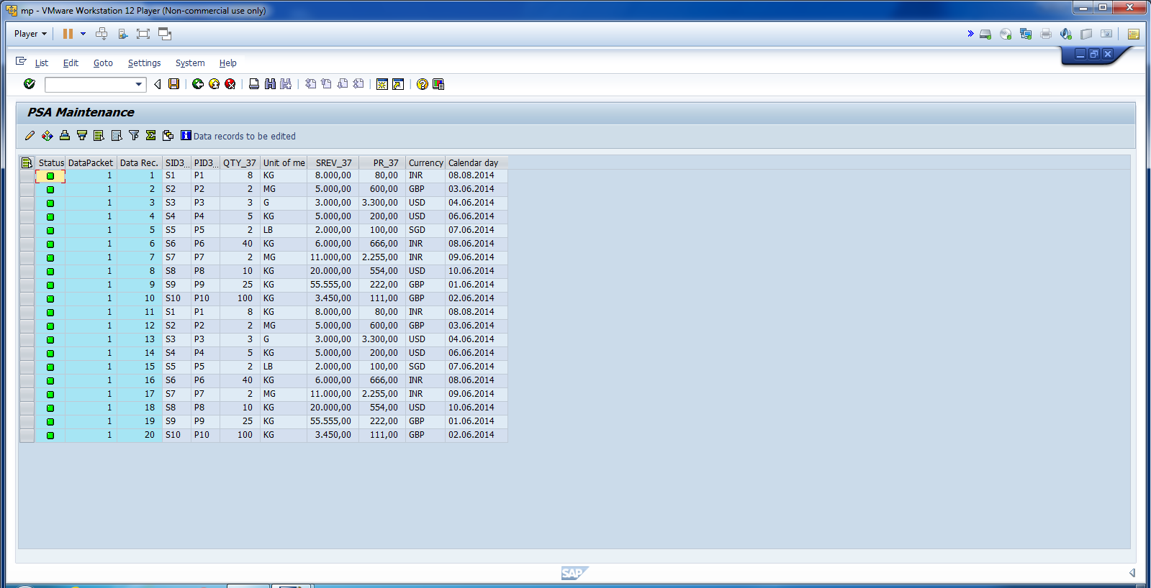
Check Data in PSA.

Slide 9
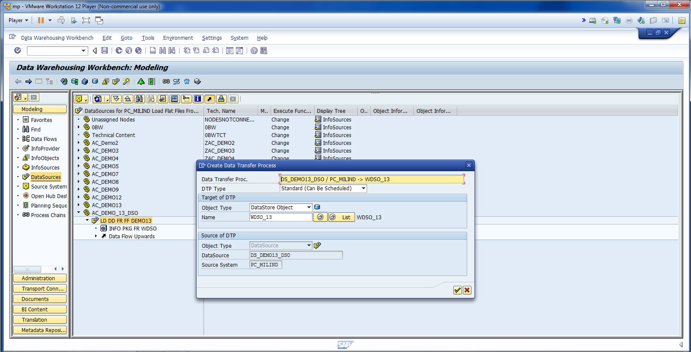
Create DTP.

Slide 10
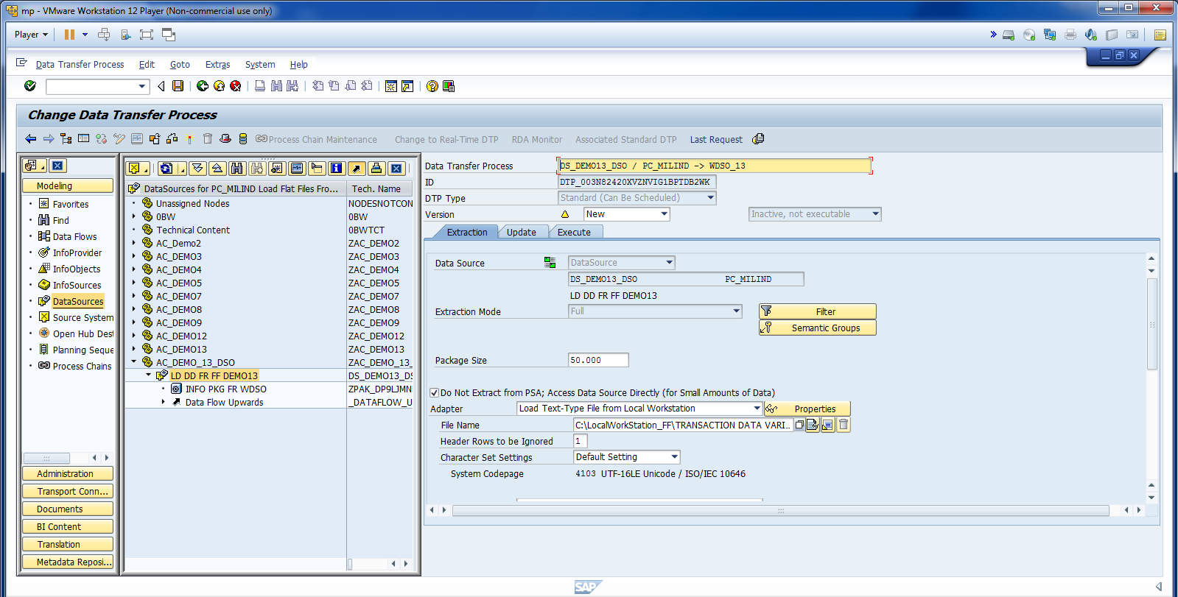
Enable Do not extract from PSA option.

Slide 11
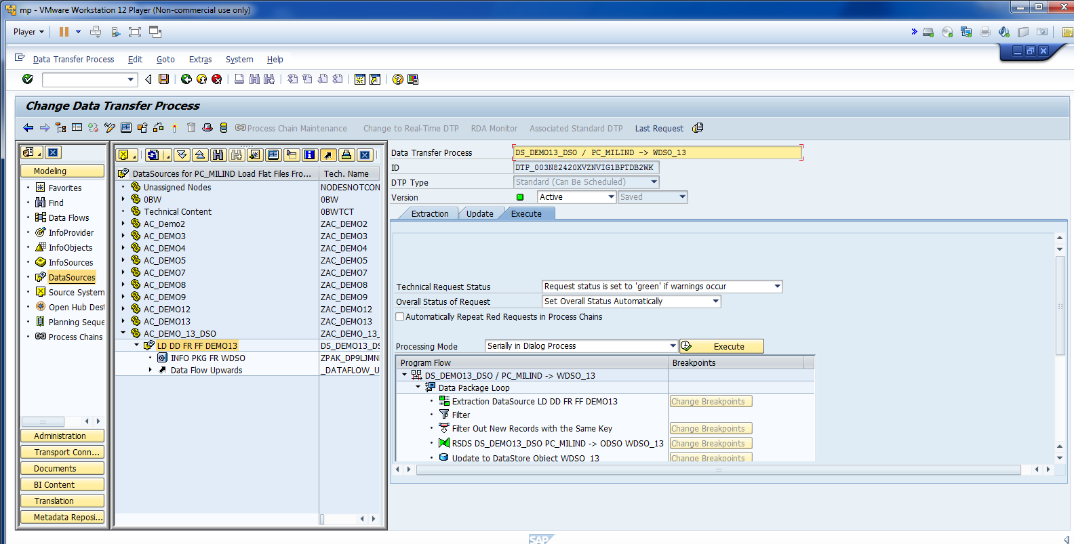
Activate and Execute.

Slide 12
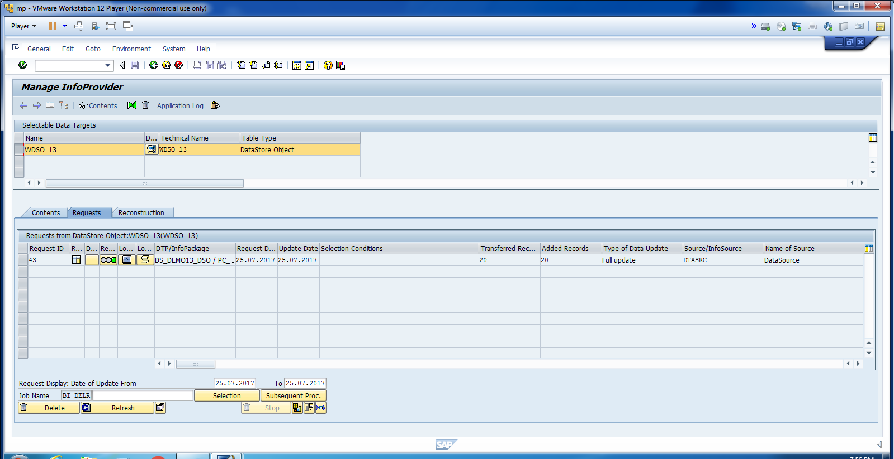
Cont.

Slide 13
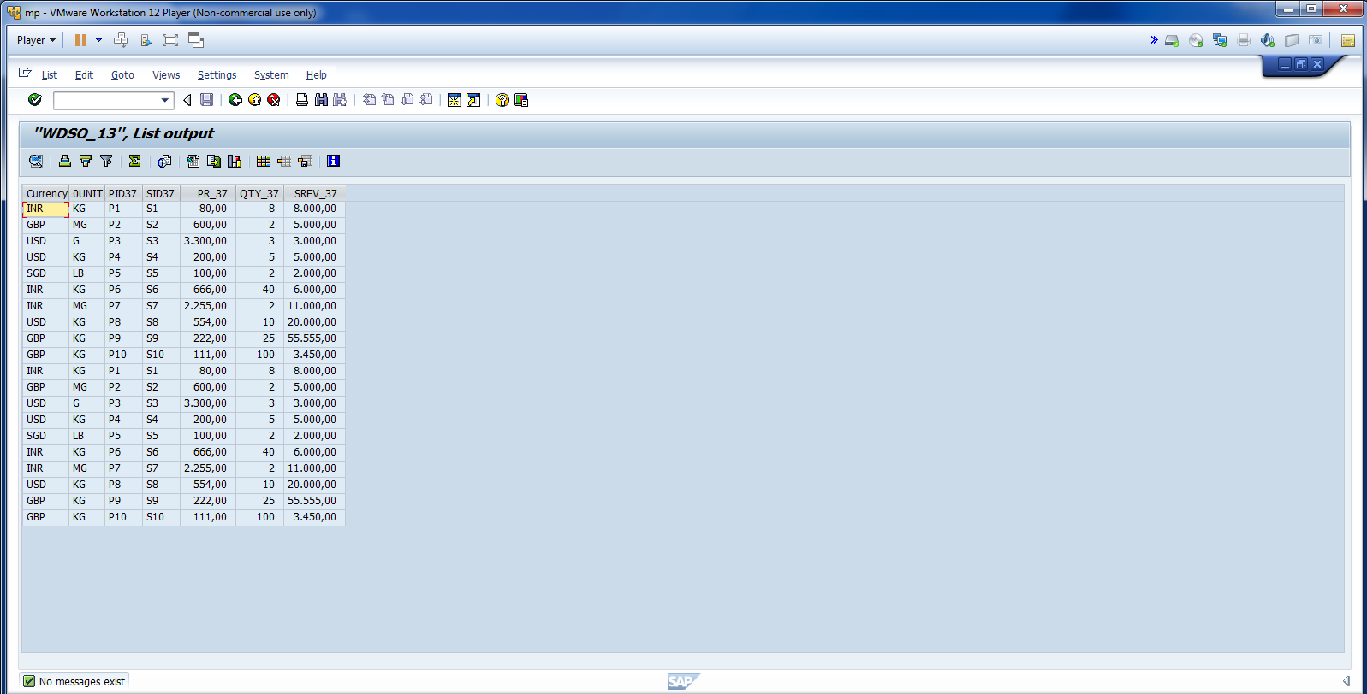
Loaded Data Successfully.

